Slide 2
DESIGN ANALYSIS AND IMPLEMENTATION OF EDUCATIONAL – DOMAIN CHATBOT SYSTEM
Submitted to:
Department of Computer Science and Engineering

Slide 3
Supervised by: Prof. Praveen Bhanodia Guided By: Prof. Shiv Shankar Rajput
Team Members-:
Nandini Bhavsar
Sameer Nagar
Shantanu Dubey

Slide 4
Acknowledgment
We take this opportunity to express our deepest and sincere gratitude to our guide Prof. Shiv Shankar Rajput, Assistant Professor, Computer Science & Engineering Department, Acropolis Institute of Technology & Research, Indore for his insightful advice, motivating suggestions, invaluable guidance, help and support in successful completion of this project and also for his constant encouragement and advice.
We express our deep gratitude to Prof. (Dr.) Praveen Bhanodia, Computer Science & Engineering Department, Acropolis Institute of Technology & Research, Indore for her regular support, co-operation, and co-ordination.

Slide 5
Acknowledgment
We express our hearty gratitude to for Dr. Kamal Kumar Sethi, Professor & Head, Computer Science & Engineering Department, Acropolis Institute of Technology & Research, Indore his support, and help provided during the project tenure.
We also express our deep gratitude to Dr. S. C. Sharma, Principal, Acropolis Institute of Technology & Research, Indore for all the help they provided for the completion of project.
The in-time facilities provided by the department throughout the Bachelors program are also equally acknowledgeable.

Slide 6
Acknowledgment
We would like to convey our thanks to the teaching and non teaching staff of the Department of Computer Science Engineering, and for their invaluable help and support throughout the period of Bachelors Degree. We are also grateful to all our classmates for their help, encouragement and invaluable suggestions.
Finally, yet more importantly, we would like to express our deep appreciation to our grandparents, parents, sister and brother for their perpetual support and encouragement throughout the Bachelors degree period.
NANDINI BHAVSAR (0827CS181127)
SAMEER NAGAR (0827CS181180)
SHANTANU DUBEY (0827CS181189)

Slide 7
Project Presentation Outline
Abstract
Introduction
Survey of Existing Systems
Project Objectives
Requirement Analysis
Solution Proposed
Methodology/Design
Models/Diagrams
Implementation and Testing
The Outcome Discussion
Conclusion
References

Slide 8
Abstract
Chatbot is an automation system and different formats of chat bots are text based, graphical, web application, and voice based.
Chatbots typically provide a text-based user interface, allowing the user to type commands and receive text as well as text to speech response.
The functionality of a Chat bot works only on the existing commands.
Chatbots usually remember previous commands in order to provide functionality.

Slide 9
Introduction
J.A.V.I.I.S. is a Chabot in educational domain.
The purpose is focused on the design of the specific architecture and model to manage communication and furnish the right answers to the students.
This system detects the questions and answers users using natural language processing techniques.
J.A.V.I.I.S. is a chat bot which helps the students to have 24*7 automated query resolution.
This helps the students to have the right information from the trusted source. This made administration of information easy

Slide 10
Survey of Existing Systems
MARTHA is a chat bot which is created and being used at George Washington University. This chat bot has the functionalities of answering the queries of students but this system do not have any access privileges. Later it was updated and used for teaching and displaying academic results.
Limitations-:Existing Chatbots don’t understand human context.
If Query is not related to inbuilt query they can’t provide related query suggestions.
Existing Chatbots are not able to generate graphical reports.
Reference Link - https://www.bmc.com/blogs/introducing-martha-leveraging-cognitive-automation-to-create-an-exceptional-student-experience/

Slide 11
Project Objectives
Our objective is to provide a chatbot that can make the communication easy.
It will not only help the administration but will also help students in communicating effectively.
We are always trying our best to improve the environment for students to help them in every way possible and our chatbot does that.
It will not only give right answers to questions, it will also help students understand the learning environment.

Slide 12
Requirement Analysis
Software Requirements-:
Python Artificial Intelligence Mark-up Language
Natural language processing tool kit
Python –flask
SQL alchemy
Hardware Requirements-:
Intel Core i3 processor
RAM: 4GB
Operating System: Windows 10
Hard Disk: 1TB

Slide 13
Solution Proposed
The main aim is to reduce the manual work in generating the reports either student wise or batch wise based on the inbuilt queries which are embedded using Chabot and also to generating the comparative graphical chart reports.
Proposed chat bot system will provide additional features like flexibility, and also friendly environment.
The flexibility features are used to retrieve the information like related query suggestion, entire information display of a particular candidate and additional query submission to the admin, computed data display.
Friendly environment is provided by an interface that is easy for user to enter the queries in natural language with out any particular format.

Slide 14
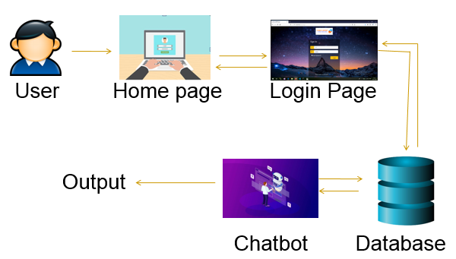
Methodology/Design

Slide 15
Models/Diagrams
Use Case Diagram for Student and Faculty
Use Case Diagram for HOD, Clerk and Admin
ER Diagram
Faculty Activity Diagram
Class Diagram
Sequence Diagram

Slide 16
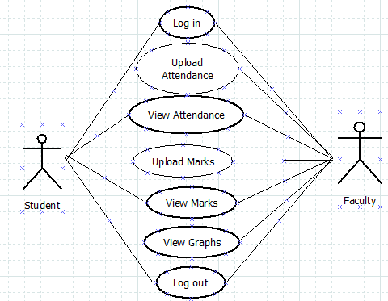
Use Case Diagram for Student and Faculty

Slide 17
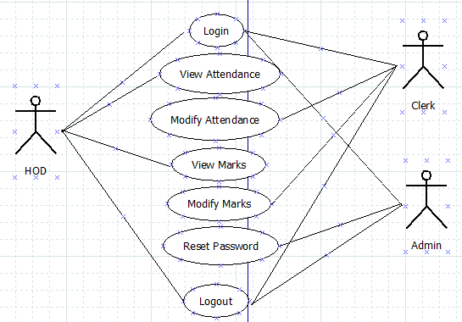
Use Case Diagram for HOD, Clerk and Admin

Slide 18
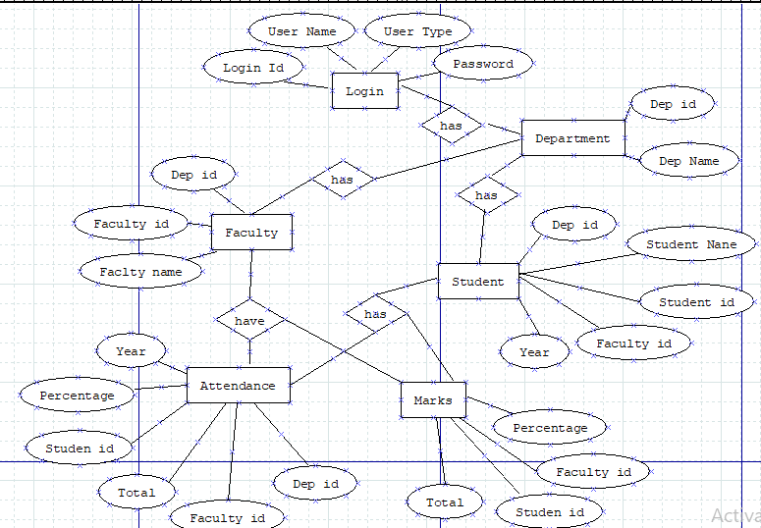
ER Diagram

Slide 19
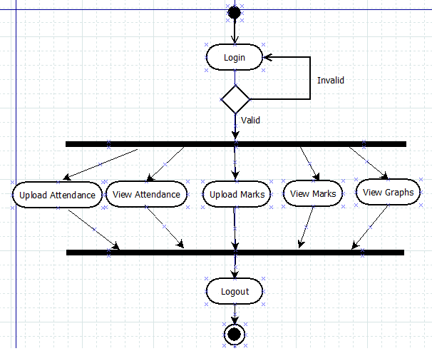
Faculty Activity Diagram

Slide 20
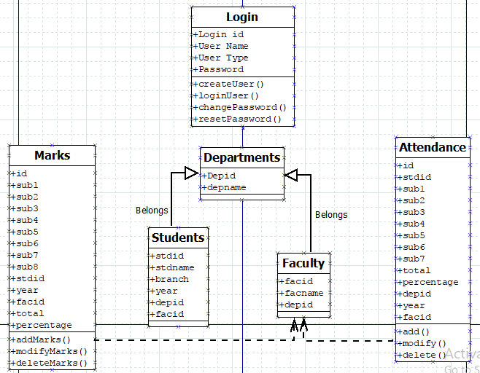
Class Diagram

Slide 21
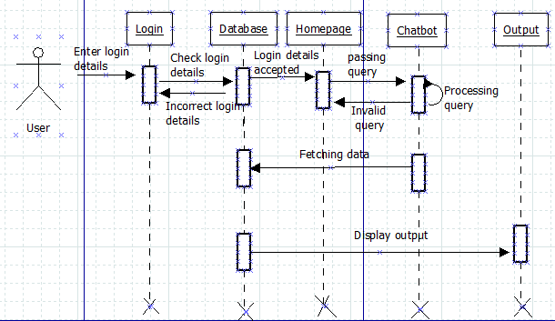
Sequence Diagram

Slide 22
Implementation and Testing
Data Collection and Loading
Creating User modules
Assigning Permissions
Implementing Chatbot
Web Application

Slide 23
Implementation and Testing
Data Collection and Loading
The Students details from 2nd year to 4th year are collected and loaded into the database.
Creating User Modules
The different modules of this chatbot system are student, faculty, HOD, clerk, admin, attendance, marks, profile, graphs, chatbot.

Slide 24
Implementation and Testing
Providing permissions
The access permissions are provided to different users based on their roles.
Implementing chatbot
The chatbot is developed in python keeping in view of its users for more flexibility.
It receives the queries from the user processes it and fetches the data from the database.
Python RegEx and NLP is used to provide flexibility to the user to communicate in natural language.
Web application
It is designed using html for the user interaction with the bot at front end.

Slide 25
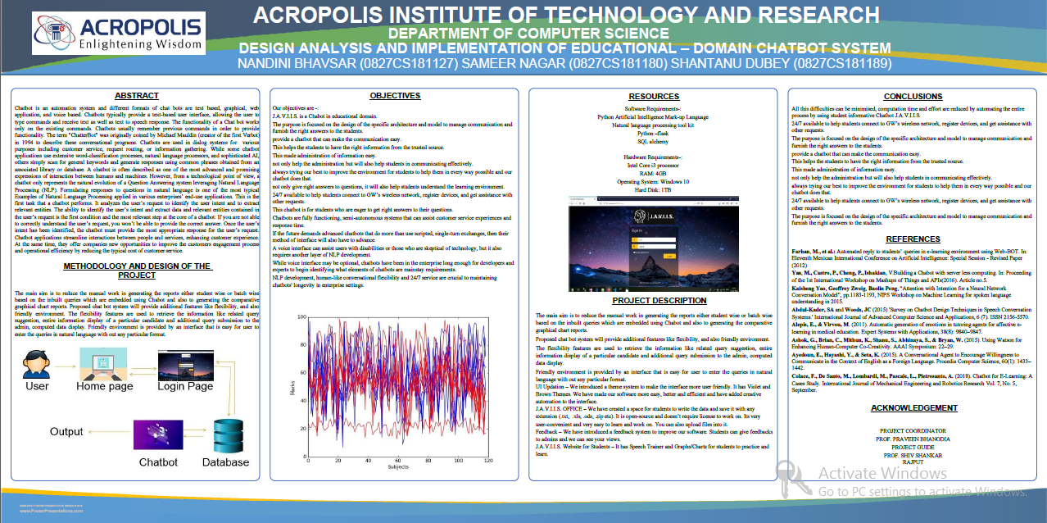
Technical Poster

Slide 26

Animated Video

Slide 27
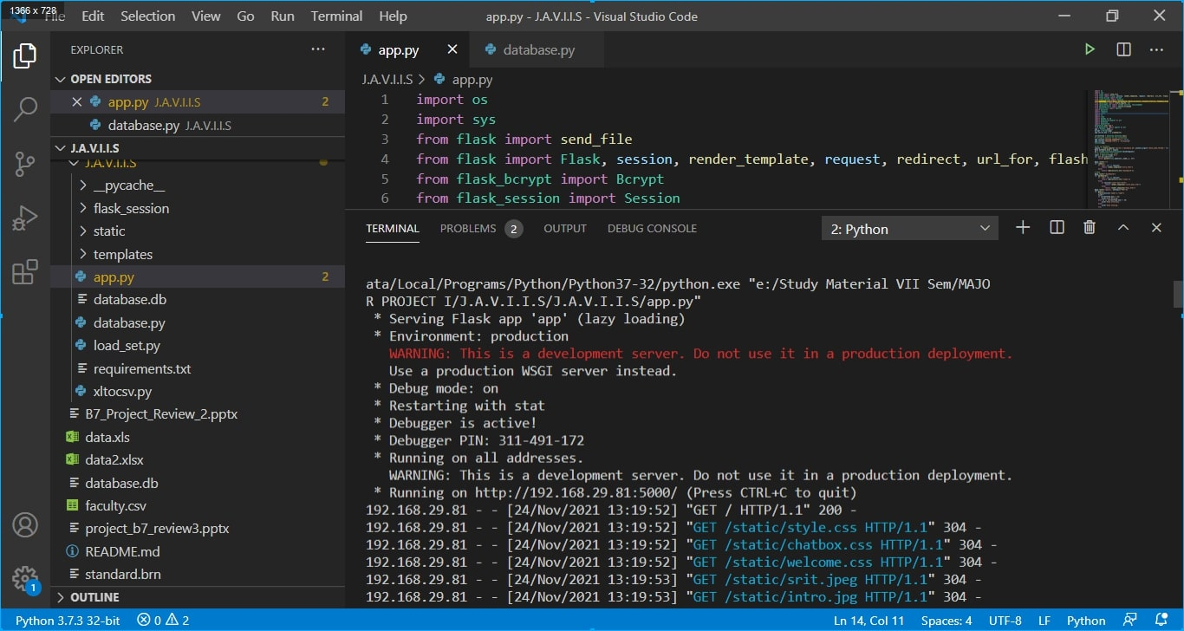
Application

Slide 28
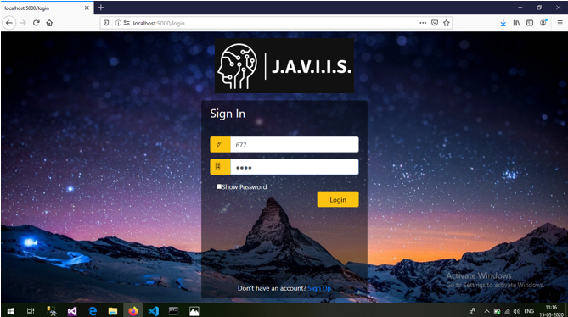
Application

Slide 29
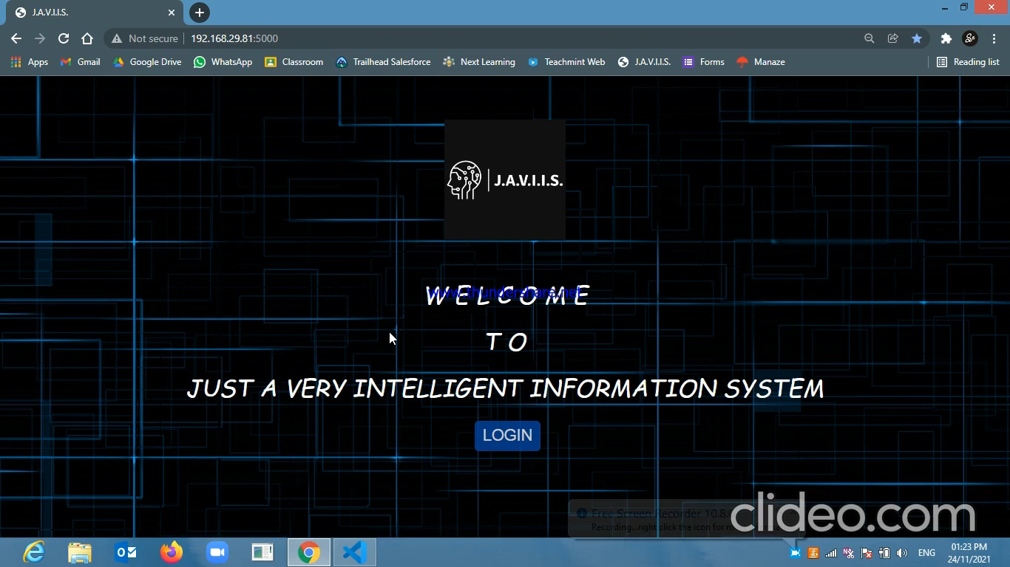
Technical Video

Slide 30
The Outcome Discussion
24/7 available to help students connect to GW’s wireless network, register devices, and get assistance with other requests.
The purpose is focused on the design of the specific architecture and model to manage communication and furnish the right answers to the students.
provide a chatbot that can make the communication easy.
This helps the students to have the right information from the trusted source.
This made administration of information easy.
not only help the administration but will also help students in communicating effectively.
always trying our best to improve the environment for students to help them in every way possible and our chatbot does that.

Slide 31
Updations in the software
UI Updation – We introduced a theme system to make the interface more user friendly. It has Violet and Brown Themes. We have made our software more easy, better and efficient and have added creative automation to the interface.
J.A.V.I.I.S. OFFICE – We have created a space for students to write the data and save it with any extension (.txt, .xls, .ods, .zip etc). It is open-source and doesn’t require license to work on. Its very user-convenient and very easy to learn and work on. You can also upload files into it.
Feedback – We have introduced a feedback system to improve our software. Students can give feedbacks to admins and we can see your views.
J.A.V.I.I.S. Website for Students – It has Speech Trainer and Graphs/Charts for students to practice and learn.

Slide 32
Conclusion
All the difficulties/limitations can be minimised, computation time and effort are reduced by automating the entire process by using student informative Chatbot J.A.V.I.I.S.

Slide 33
References
Farhan, M., et al.: Automated reply to students’ queries in e-learning environment using Web-BOT. In: Eleventh Mexican International Conference on Artificial Intelligence: Special Session - Revised Paper (2012)
Yan, M., Castro, P., Cheng, P., Ishakian, V.Building a Chabot with server less computing. In: Proceeding of the 1st International Workshop on Mashups of Things and APIs(2016). Article no.5.
Kaisheng Yao, Geoffrey Zweig, Baolin Peng, “Attention with Intention for a Neural Network Conversation Model”, pp.1183-1193, NIPS Workshop on Machine Learning for spoken language understanding in 2015.
Abdul-Kader, SA and Woods, JC (2015) 'Survey on Chatbot Design Techniques in Speech Conversation Systems.' International Journal of Advanced Computer Science and Applications, 6 (7). ISSN 2156-5570.

Slide 34
Q&A

Slide 35
THANKS

